Slide 1
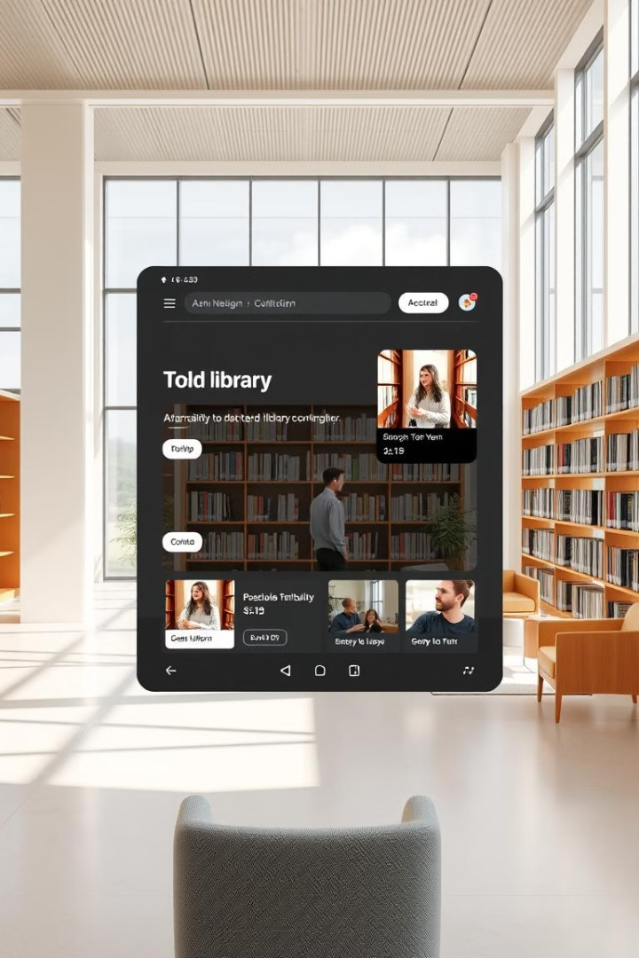

Streamlining Libraries with Python: A Visual Tour
Libraries face challenges with manual tasks and tracking. A Python offers streamlined solutions for efficient management and simplified code.
by KAPADIYA ABHI

Slide 2
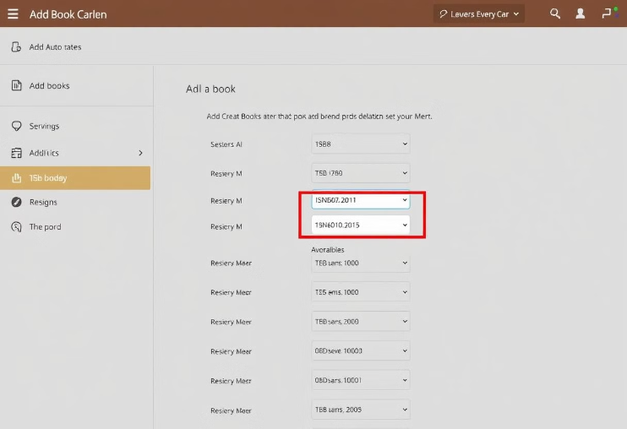
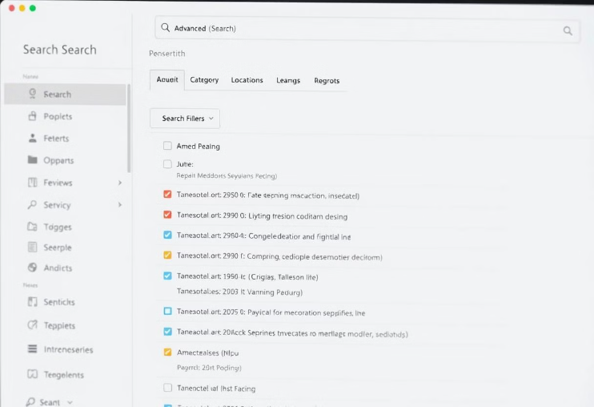
Core Features: Visual Demo
Fast Book Addition
Advanced Search
Add new books quickly. Use ISBN lookup with auto-populated fields.
Search for books by title, author, keyword, or availability with ease.
See the system in action. This is a demonstration.

Slide 3
Managing Members: Quick and Easy
Add New Members
1
Quick data entry and automatic ID generation simplifies membership management.
2
Track Borrowing History
Clear display of borrowed books and due dates for easy tracking.
books managments
3
The system add and remove books and issue the books.
Membership is handled efficiently and intuitively.

Slide 4



Borrowing & Returning: A Seamless Process
Borrowing
Returning
Real-time Updates
enter ID, assign book, and set due date effortlessly.
enter ID, mark as returned, and check for fines.
Inventory updates immediately upon borrowing or returning.
This highlights the user experience for core library actions.

Slide 5


Reports & Analytics: Data-Driven Insights
Popular Books
Member Activity
Identify trends and inform purchasing decisions.
Track usage and identify inactive members easily.

Slide 6
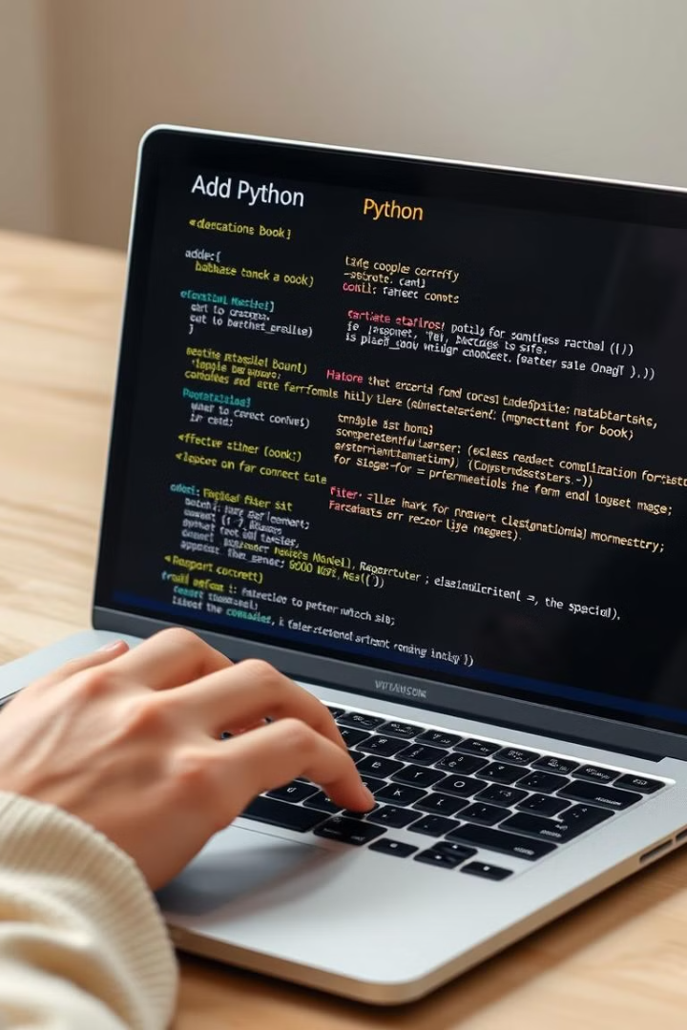
Code Simplicity: Python at its Best
1
Key Libraries
2
Modular Design
Utilize Python libraries like Tkinter for GUI and SQLite for database.
Easy to extend and customize the system.
3
Easy to Maintain
The LMS is simple to understand and expand upon.

Slide 7

Conclusion: Modernize Your Library Today
Efficiency
Ease of Use
Streamline library operations.
User-friendly interface for all.
Data-Driven
Make informed decisions with analytics.
Explore the system and contribute to its development. Modernize your library today.

Slide 8
Thank You

